Slide 1
Green TAC
Carbon-Aware Adaptive Three-Address Code Optimization for Green Compilation
Final Review Presentation
Presented by Awadh Kumar Dhoot , Lakshyajeet Narsinghani, Mohammed Wasif
Reg. No: 24BCE2589,24BCE2419, 24BCE2523
VIT School of Computer Science and Engineering
Notes:
Replace the name, reg no and guide placeholders. Repo: github.com/Lakshyajeet3103/Green-TAC (branch feature/intermediate-steps).

Slide 2
Why Green Compilation?
Compilers decide how much work the program does, every time it runs
The problem
The idea
The contribution
Optimizing harder costs compile-time energy.
Not optimizing costs runtime energy on every execution.
No fixed answer: it depends on how often the program runs and how clean the grid is.
Treat energy and carbon as a first-class compiler cost.
Generate several candidate TAC versions, estimate each one's carbon, and pick the best.
A small C++ research compiler with three TAC strategies and a carbon-aware selector.
Python tooling for benchmarking, calibration and analysis.

Slide 3
Objectives and Research Question
Does an adaptive policy reduce total estimated/measured carbon versus fixed policies, while keeping runtime acceptable?
Build a lexer, parser, AST and baseline TAC generator in C++
Implement three candidate strategies: baseline, lightweight, DAG/CSE
Model total energy and CO2e with separate compile and runtime carbon intensities
Select the greenest strategy per program, given expected executions N
Evaluate against always-baseline, always-lightweight and always-DAG

Slide 4
Codebase Overview
C++ for the compiler, Python only for build, benchmarks and analysis. No CMake or Makefile needed.
src/ + include/greentac/ | Compiler core: lexer, parser, TAC, optimizer (lightweight, DAG), steps walkthrough, selector
benchmarks/ | Sample C programs such as cse.c
tests/ | Test cases run through python run.py test
tools/ | generate_benchmarks, run_benchmarks, analyze_results, fit_model, fetch_carbon_dataset
data/ | Benchmark manifest, measurements, model files, carbon datasets
build.py / run.py | Build driver and CLI: tac, steps, compare, green, test, info
PROJECT_SPEC.md / RESEARCH_WORKFLOW.md | Design spec and research methodology

Slide 5
Compiler Pipeline
Source program in, carbon-selected TAC out
Front end
Source program
Lexer
Parser
AST
Baseline TAC
Green back end
Candidate strategies
Empirical cost model
Carbon calculation
Green selection
Final TAC / optional C
Baseline TAC feeds the candidate strategies, which are scored and compared before the final TAC is emitted.

Slide 6
Three Candidate Strategies
Each produces valid TAC for the same program
Baseline
Lightweight
DAG / CSE
Direct translation of the AST into TAC.
No optimization pass. Compile cost depends on the program.
Reference TAC instruction and temporary counts.
Forward local pass over the TAC.
Constant folding, algebraic simplification and copy propagation.
Conservative: resets at control-flow boundaries.
Runs on top of the lightweight output.
Builds a local DAG so repeated expressions reuse one node.
DAG resets at assignments and control flow.

Slide 7
Intermediate Steps Walkthrough
One command shows every compiler stage for either example
$ python run.py steps benchmarks/cse.c
0 Source
1 Tokens
2 AST
3 Baseline TAC
Numbered source lines of the program being compiled.
One row per source line; @column marks each token's position.
ASCII tree of Assign, Block, If and While with then/else branches.
Numbered TAC lines, one temporary per computation.
4 Lightweight
5 Local DAG / CSE
6 Final DAG TAC
Result
Before => After [reason]: folding, simplification, copy propagation.
Nodes n1, n2 with lhs/rhs edges; Reuse n.. marks eliminated work.
Code after simplification and reuse; matches --strategy dag.
Baseline vs optimized side by side, with instruction counts and removed total.
Notes:
The binary also supports: green_tac steps <file>. Final TAC matches python run.py tac benchmarks/cse.c --strategy dag.

Slide 8
Energy and Carbon Model
Physical measurements are kept separate from proxy estimates
E_total = E_compile + N * E_runtime
CO2e = E_compile * CI_compile / 3.6e6
+ N * E_runtime * CI_runtime / 3.6e6
Key insight
If one carbon intensity is applied to every phase, it is just a common multiplier and cannot change the ranking.
So the model uses separate compile-time and runtime intensities.
Energy in joules, CI in gCO2e/kWh, N = expected executions.
Total carbon depends on both phases, so the winner changes with N and the grid.

Slide 9
Carbon-Aware Strategy Selector
Compare predicted CO2e for each candidate, then choose
1
2
3
4
Generate
Estimate
Convert
Select
Baseline, lightweight and DAG TAC for the program
Calibrated metrics where available, labeled proxies otherwise
Apply CI_compile, CI_runtime and N to get CO2e
Pick the lowest-carbon strategy within the runtime-overhead constraint
Run it: python run.py green benchmarks/cse.c --compile-ci 700 --runtime-ci 200 --executions 10000

Slide 10
Experimental Workflow
Reproducible data collection, analysis and calibration
Generate corpus
python tools/generate_benchmarks.py --count 120
Arithmetic, CSE-heavy, constant-heavy, loop-heavy and mixed programs
Measure
python tools/run_benchmarks.py --runs 50 --clean
Records every strategy into data/measurements.csv
Analyze
python tools/analyze_results.py data/measurements.csv
Summary statistics per strategy
Calibrate
python tools/fit_model.py data/measurements.csv data/model.csv
Writes data/model_metrics.csv; split by program, not by run

Slide 11
Energy Measurement and Carbon Data
Real measurements only; nothing is invented
Energy measurement
Carbon-intensity datasets
On Linux with a supported powercap/RAPL energy_uj counter, scripts record physical energy.
On unsupported systems, energy is left blank rather than filled with made-up values.
Check the provider: python run.py info
India: Ember monthly electricity dataset (tools/fetch_carbon_dataset.py).
Hourly option: Electricity Maps historical API, subject to academic access.
Great Britain: official Carbon Intensity API.
Grid data is kept separate from compiler-energy training data.

Slide 12
Example 1: Boolean if/else
python run.py steps benchmarks/cse.c
if ((a < b && c != d) || (e >= f && (g < h || p == q))) {
result = result + 1;
} else {
result = result - 1;
}
Nested Boolean condition with if/else. Short-circuit jumps preserve the logical structure. This example has no repeated arithmetic work to remove.
Notes:
Input file: benchmarks/cse.c
if ((a < b && c != d) || (e >= f && (g < h || p == q))) {
result = result + 1;
} else {
result = result - 1;
}

Slide 13
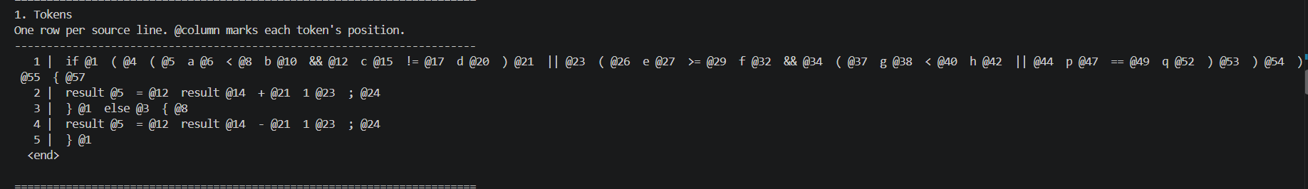
Example 1: Tokens
python run.py steps benchmarks/cse.c
Every token and its source column. Long source rows continue on the next display line.
Notes:
Command: python run.py steps benchmarks/cse.c
1. Tokens
One row per source line. @column marks each token's position.
1 | if @1 ( @4 ( @5 a @6 < @8 b @10 && @12 c @15 != @17 d @20 ) @21 || @23 ( @26 e @27 >= @29 f @32 && @34 ( @37 g @38 < @40 h @42 || @44 p @47 == @49 q @52 ) @53 ) @54 ) @55 { @57
2 | result @5 = @12 result @14 + @21 1 @23 ; @24
3 | } @1 else @3 { @8
4 | result @5 = @12 result @14 - @21 1 @23 ; @24
5 | } @1
<end>

Slide 14
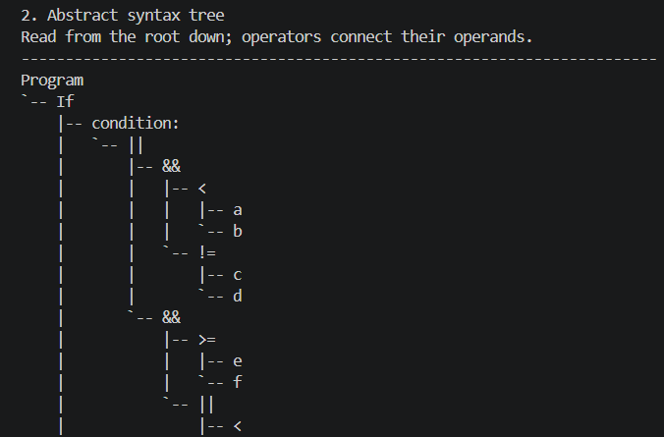
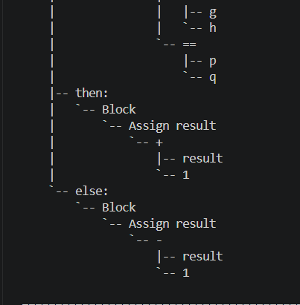
Example 1: Abstract syntax tree
python run.py steps benchmarks/cse.c
Read the left column first, then continue at the top of the right column.
Notes:
Command: python run.py steps benchmarks/cse.c
2. Abstract syntax tree
Read from the root down; operators connect their operands.
Program
`-- If
|-- condition:
| `-- ||
| |-- &&
| | |-- <
| | | |-- a
| | | `-- b
| | `-- !=
| | |-- c
| | `-- d
| `-- &&
| |-- >=
| | |-- e
| | `-- f
| `-- ||
| |-- <
| | |-- g
| | `-- h
| `-- ==
| |-- p
| `-- q
|-- then:
| `-- Block
| `-- Assign result
| `-- +
| |-- result
| `-- 1
`-- else:
`-- Block
`-- Assign result
`-- -
|-- result
`-- 1

Slide 15
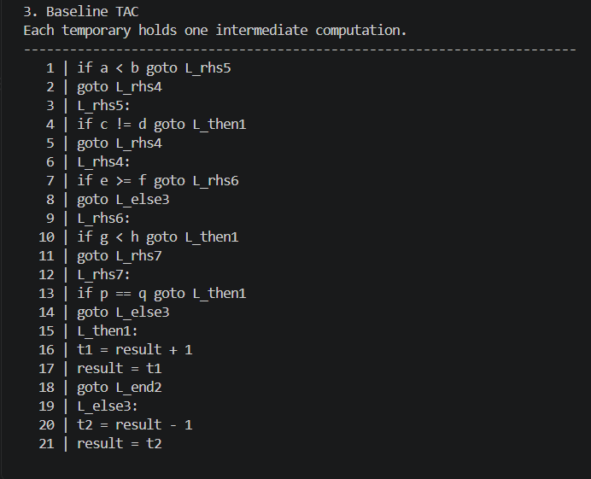
Example 1: Baseline TAC
python run.py steps benchmarks/cse.c
22 instructions before optimization.
1 | if a < b goto L_rhs5
2 | goto L_rhs4
3 | L_rhs5:
4 | if c != d goto L_then1
5 | goto L_rhs4
6 | L_rhs4:
7 | if e >= f goto L_rhs6
8 | goto L_else3
9 | L_rhs6:
10 | if g < h goto L_then1
11 | goto L_rhs7
12 | L_rhs7:
13 | if p == q goto L_then1
14 | goto L_else3
15 | L_then1:
16 | t1 = result + 1
17 | result = t1
18 | goto L_end2
19 | L_else3:
20 | t2 = result - 1
21 | result = t2
22 | L_end2:
Notes:
Command: python run.py steps benchmarks/cse.c
3. Baseline TAC
Each temporary holds one intermediate computation.
1 | if a < b goto L_rhs5
2 | goto L_rhs4
3 | L_rhs5:
4 | if c != d goto L_then1
5 | goto L_rhs4
6 | L_rhs4:
7 | if e >= f goto L_rhs6
8 | goto L_else3
9 | L_rhs6:
10 | if g < h goto L_then1
11 | goto L_rhs7
12 | L_rhs7:
13 | if p == q goto L_then1
14 | goto L_else3
15 | L_then1:
16 | t1 = result + 1
17 | result = t1
18 | goto L_end2
19 | L_else3:
20 | t2 = result - 1
21 | result = t2
22 | L_end2:

Slide 16
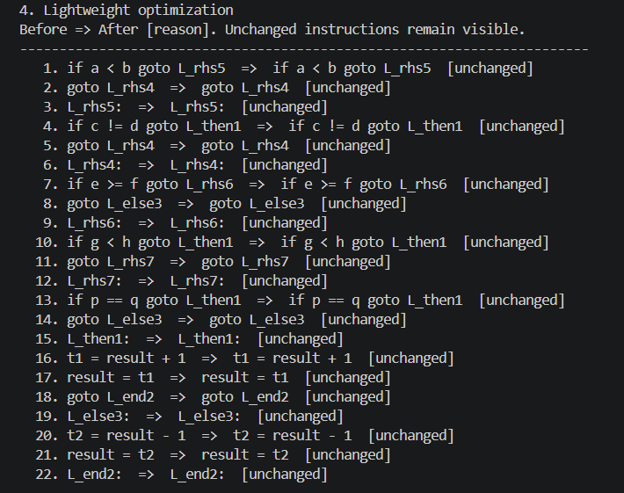
Example 1: Lightweight rewrites
python run.py steps benchmarks/cse.c
Before => After [reason]. Unchanged instructions remain visible.
Notes:
Command: python run.py steps benchmarks/cse.c
4. Lightweight optimization
Before => After [reason]. Unchanged instructions remain visible.
1. if a < b goto L_rhs5 => if a < b goto L_rhs5 [unchanged]
2. goto L_rhs4 => goto L_rhs4 [unchanged]
3. L_rhs5: => L_rhs5: [unchanged]
4. if c != d goto L_then1 => if c != d goto L_then1 [unchanged]
5. goto L_rhs4 => goto L_rhs4 [unchanged]
6. L_rhs4: => L_rhs4: [unchanged]
7. if e >= f goto L_rhs6 => if e >= f goto L_rhs6 [unchanged]
8. goto L_else3 => goto L_else3 [unchanged]
9. L_rhs6: => L_rhs6: [unchanged]
10. if g < h goto L_then1 => if g < h goto L_then1 [unchanged]
11. goto L_rhs7 => goto L_rhs7 [unchanged]
12. L_rhs7: => L_rhs7: [unchanged]
13. if p == q goto L_then1 => if p == q goto L_then1 [unchanged]
14. goto L_else3 => goto L_else3 [unchanged]
15. L_then1: => L_then1: [unchanged]
16. t1 = result + 1 => t1 = result + 1 [unchanged]
17. result = t1 => result = t1 [unchanged]
18. goto L_end2 => goto L_end2 [unchanged]
19. L_else3: => L_else3: [unchanged]
20. t2 = result - 1 => t2 = result - 1 [unchanged]
21. result = t2 => result = t2 [unchanged]
22. L_end2: => L_end2: [unchanged]

Slide 17
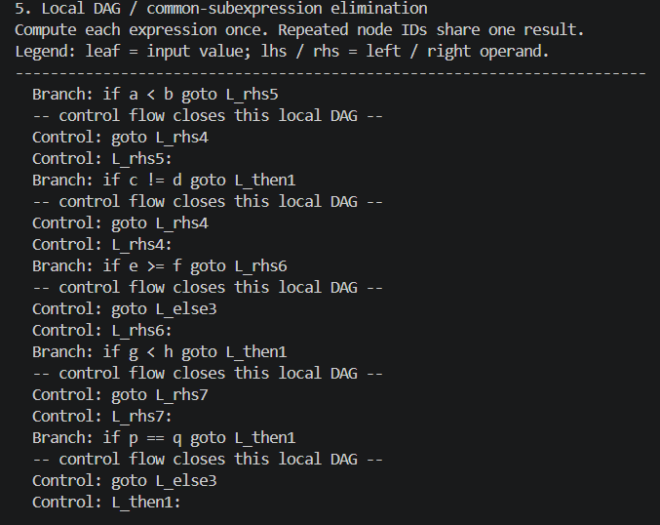
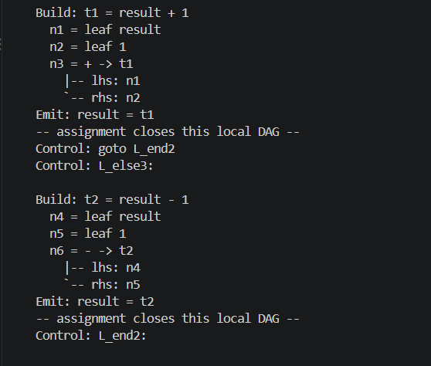
Example 1: DAG / CSE trace
python run.py steps benchmarks/cse.c
Read the left column first. Reuse marks eliminated expressions. Control flow closes each local DAG.
Branch: if a < b goto L_rhs5
-- control flow closes this local DAG --
Control: goto L_rhs4
Control: L_rhs5:
Branch: if c != d goto L_then1
-- control flow closes this local DAG --
Control: goto L_rhs4
Control: L_rhs4:
Branch: if e >= f goto L_rhs6
-- control flow closes this local DAG --
Control: goto L_else3
Control: L_rhs6:
Branch: if g < h goto L_then1
-- control flow closes this local DAG --
Control: goto L_rhs7
Control: L_rhs7:
Branch: if p == q goto L_then1
-- control flow closes this local DAG --
Control: goto L_else3
Control: L_then1:
Build: t1 = result + 1
n1 = leaf result
n2 = leaf 1
n3 = + -> t1
|-- lhs: n1
`-- rhs: n2
Emit: result = t1
-- assignment closes this local DAG --
Control: goto L_end2
Control: L_else3:
Build: t2 = result - 1
n4 = leaf result
n5 = leaf 1
n6 = - -> t2
|-- lhs: n4
`-- rhs: n5
Emit: result = t2
-- assignment closes this local DAG --
Control: L_end2:
Notes:
Command: python run.py steps benchmarks/cse.c
5. Local DAG / common-subexpression elimination
Compute each expression once. Repeated node IDs share one result.
Legend: leaf = input value; lhs / rhs = left / right operand.
Branch: if a < b goto L_rhs5
-- control flow closes this local DAG --
Control: goto L_rhs4
Control: L_rhs5:
Branch: if c != d goto L_then1
-- control flow closes this local DAG --
Control: goto L_rhs4
Control: L_rhs4:
Branch: if e >= f goto L_rhs6
-- control flow closes this local DAG --
Control: goto L_else3
Control: L_rhs6:
Branch: if g < h goto L_then1
-- control flow closes this local DAG --
Control: goto L_rhs7
Control: L_rhs7:
Branch: if p == q goto L_then1
-- control flow closes this local DAG --
Control: goto L_else3
Control: L_then1:
Build: t1 = result + 1
n1 = leaf result
n2 = leaf 1
n3 = + -> t1
|-- lhs: n1
`-- rhs: n2
Emit: result = t1
-- assignment closes this local DAG --
Control: goto L_end2
Control: L_else3:
Build: t2 = result - 1
n4 = leaf result
n5 = leaf 1
n6 = - -> t2
|-- lhs: n4
`-- rhs: n5
Emit: result = t2
-- assignment closes this local DAG --
Control: L_end2:

Slide 18
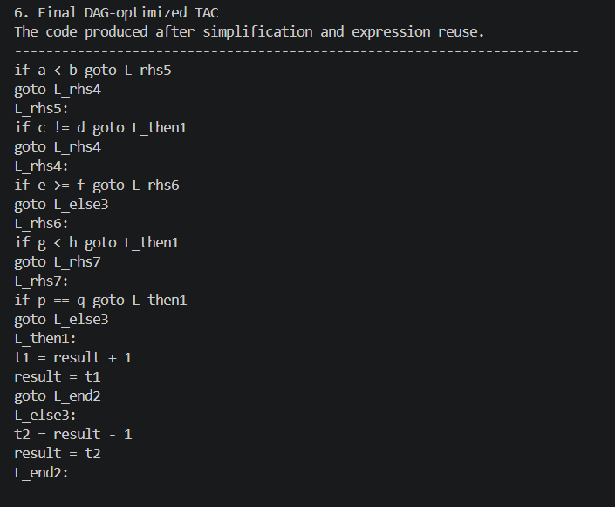
Example 1: Final DAG TAC
python run.py steps benchmarks/cse.c
Notes:
Command: python run.py steps benchmarks/cse.c
6. Final DAG-optimized TAC
The code produced after simplification and expression reuse.
if a < b goto L_rhs5
goto L_rhs4
L_rhs5:
if c != d goto L_then1
goto L_rhs4
L_rhs4:
if e >= f goto L_rhs6
goto L_else3
L_rhs6:
if g < h goto L_then1
goto L_rhs7
L_rhs7:
if p == q goto L_then1
goto L_else3
L_then1:
t1 = result + 1
result = t1
goto L_end2
L_else3:
t2 = result - 1
result = t2
L_end2:

Slide 19
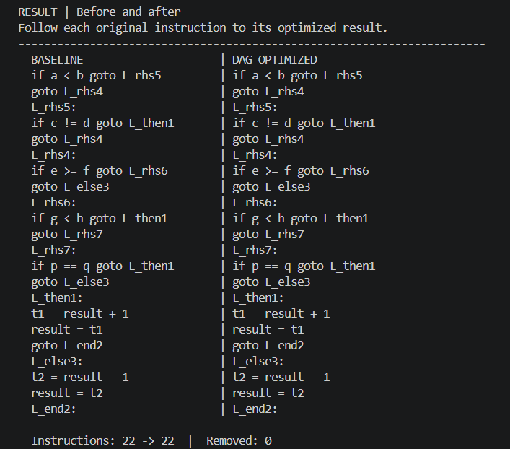
Example 1: Before and after
python run.py steps benchmarks/cse.c
Every baseline instruction appears beside its optimized result.
Notes:
Command: python run.py steps benchmarks/cse.c
RESULT | Before and after
Follow each original instruction to its optimized result.
BASELINE | DAG OPTIMIZED
if a < b goto L_rhs5 | if a < b goto L_rhs5
goto L_rhs4 | goto L_rhs4
L_rhs5: | L_rhs5:
if c != d goto L_then1 | if c != d goto L_then1
goto L_rhs4 | goto L_rhs4
L_rhs4: | L_rhs4:
if e >= f goto L_rhs6 | if e >= f goto L_rhs6
goto L_else3 | goto L_else3
L_rhs6: | L_rhs6:
if g < h goto L_then1 | if g < h goto L_then1
goto L_rhs7 | goto L_rhs7
L_rhs7: | L_rhs7:
if p == q goto L_then1 | if p == q goto L_then1
goto L_else3 | goto L_else3
L_then1: | L_then1:
t1 = result + 1 | t1 = result + 1
result = t1 | result = t1
goto L_end2 | goto L_end2
L_else3: | L_else3:
t2 = result - 1 | t2 = result - 1
result = t2 | result = t2
L_end2: | L_end2:
Instructions: 22 -> 22 | Removed: 0

Slide 20
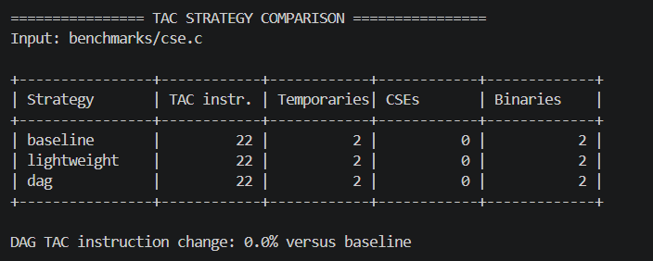
Example 1: Strategy comparison
python run.py compare benchmarks/cse.c
All three strategies retain 22 instructions. Short-circuit control flow is the important result here. There is no local expression reuse to remove.
Notes:
================ TAC STRATEGY COMPARISON ================
Input: benchmarks/cse.c
+----------------+------------+------------+------------+-------------+
| Strategy | TAC instr. | Temporaries| CSEs | Binaries |
+----------------+------------+------------+------------+-------------+
| baseline | 22 | 2 | 0 | 2 |
| lightweight | 22 | 2 | 0 | 2 |
| dag | 22 | 2 | 0 | 2 |
+----------------+------------+------------+------------+-------------+
DAG TAC instruction change: 0.0% versus baseline
### baseline
-------------------------------- TAC --------------------------------
if a < b goto L_rhs5
goto L_rhs4
L_rhs5:
if c != d goto L_then1
goto L_rhs4
L_rhs4:
if e >= f goto L_rhs6
goto L_else3
L_rhs6:
if g < h goto L_then1
goto L_rhs7
L_rhs7:
if p == q goto L_then1
goto L_else3
L_then1:
t1 = result + 1
result = t1
goto L_end2
L_else3:
t2 = result - 1
result = t2
L_end2:
------------------------------------------------------------------------
### lightweight
-------------------------------- TAC --------------------------------
if a < b goto L_rhs5
goto L_rhs4
L_rhs5:
if c != d goto L_then1
goto L_rhs4
L_rhs4:
if e >= f goto L_rhs6
goto L_else3
L_rhs6:
if g < h goto L_then1
goto L_rhs7
L_rhs7:
if p == q goto L_then1
goto L_else3
L_then1:
t1 = result + 1
result = t1
goto L_end2
L_else3:
t2 = result - 1
result = t2
L_end2:
------------------------------------------------------------------------
### dag
-------------------------------- TAC --------------------------------
if a < b goto L_rhs5
goto L_rhs4
L_rhs5:
if c != d goto L_then1
goto L_rhs4
L_rhs4:
if e >= f goto L_rhs6
goto L_else3
L_rhs6:
if g < h goto L_then1
goto L_rhs7
L_rhs7:
if p == q goto L_then1
goto L_else3
L_then1:
t1 = result + 1
result = t1
goto L_end2
L_else3:
t2 = result - 1
result = t2
L_end2:
------------------------------------------------------------------------
CSEs counts repeated expressions remaining in the output, not the number of expressions removed.

Slide 21
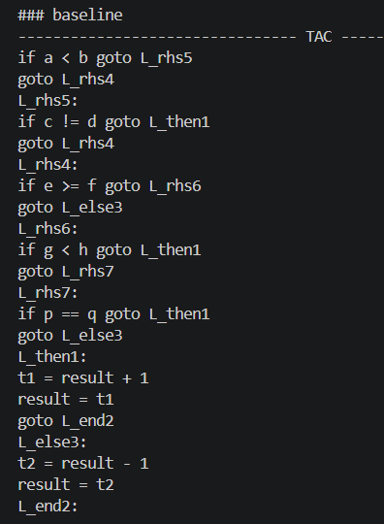
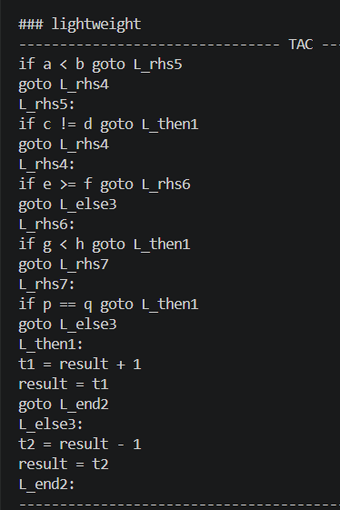
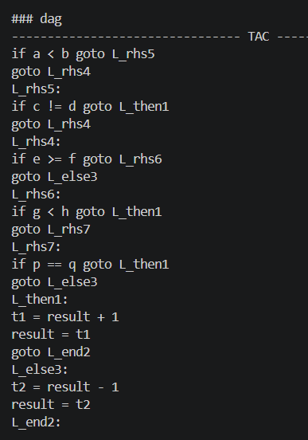
Example 1: TAC across all strategies
python run.py compare benchmarks/cse.c
BASELINE
LIGHTWEIGHT
DAG
if a < b goto L_rhs5
goto L_rhs4
L_rhs5:
if c != d goto L_then1
goto L_rhs4
L_rhs4:
if e >= f goto L_rhs6
goto L_else3
L_rhs6:
if g < h goto L_then1
goto L_rhs7
L_rhs7:
if p == q goto L_then1
goto L_else3
L_then1:
t1 = result + 1
result = t1
goto L_end2
L_else3:
t2 = result - 1
result = t2
L_end2:
if a < b goto L_rhs5
goto L_rhs4
L_rhs5:
if c != d goto L_then1
goto L_rhs4
L_rhs4:
if e >= f goto L_rhs6
goto L_else3
L_rhs6:
if g < h goto L_then1
goto L_rhs7
L_rhs7:
if p == q goto L_then1
goto L_else3
L_then1:
t1 = result + 1
result = t1
goto L_end2
L_else3:
t2 = result - 1
result = t2
L_end2:
if a < b goto L_rhs5
goto L_rhs4
L_rhs5:
if c != d goto L_then1
goto L_rhs4
L_rhs4:
if e >= f goto L_rhs6
goto L_else3
L_rhs6:
if g < h goto L_then1
goto L_rhs7
L_rhs7:
if p == q goto L_then1
goto L_else3
L_then1:
t1 = result + 1
result = t1
goto L_end2
L_else3:
t2 = result - 1
result = t2
L_end2:
Notes:
================ TAC STRATEGY COMPARISON ================
Input: benchmarks/cse.c
+----------------+------------+------------+------------+-------------+
| Strategy | TAC instr. | Temporaries| CSEs | Binaries |
+----------------+------------+------------+------------+-------------+
| baseline | 22 | 2 | 0 | 2 |
| lightweight | 22 | 2 | 0 | 2 |
| dag | 22 | 2 | 0 | 2 |
+----------------+------------+------------+------------+-------------+
DAG TAC instruction change: 0.0% versus baseline
### baseline
-------------------------------- TAC --------------------------------
if a < b goto L_rhs5
goto L_rhs4
L_rhs5:
if c != d goto L_then1
goto L_rhs4
L_rhs4:
if e >= f goto L_rhs6
goto L_else3
L_rhs6:
if g < h goto L_then1
goto L_rhs7
L_rhs7:
if p == q goto L_then1
goto L_else3
L_then1:
t1 = result + 1
result = t1
goto L_end2
L_else3:
t2 = result - 1
result = t2
L_end2:
------------------------------------------------------------------------
### lightweight
-------------------------------- TAC --------------------------------
if a < b goto L_rhs5
goto L_rhs4
L_rhs5:
if c != d goto L_then1
goto L_rhs4
L_rhs4:
if e >= f goto L_rhs6
goto L_else3
L_rhs6:
if g < h goto L_then1
goto L_rhs7
L_rhs7:
if p == q goto L_then1
goto L_else3
L_then1:
t1 = result + 1
result = t1
goto L_end2
L_else3:
t2 = result - 1
result = t2
L_end2:
------------------------------------------------------------------------
### dag
-------------------------------- TAC --------------------------------
if a < b goto L_rhs5
goto L_rhs4
L_rhs5:
if c != d goto L_then1
goto L_rhs4
L_rhs4:
if e >= f goto L_rhs6
goto L_else3
L_rhs6:
if g < h goto L_then1
goto L_rhs7
L_rhs7:
if p == q goto L_then1
goto L_else3
L_then1:
t1 = result + 1
result = t1
goto L_end2
L_else3:
t2 = result - 1
result = t2
L_end2:
------------------------------------------------------------------------

Slide 22
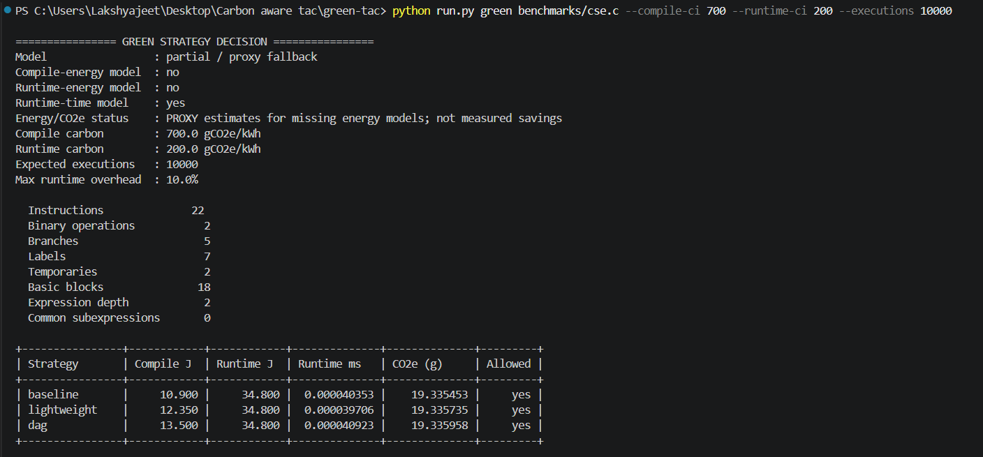
Example 1: Selector inputs and features
python run.py green benchmarks/cse.c --compile-ci 700 --runtime-ci 200 --executions 10000
Energy and CO2e use proxy estimates. The fitted runtime model has poor documented holdout accuracy.
Notes:
================ GREEN STRATEGY DECISION ================
Model : partial / proxy fallback
Compile-energy model : no
Runtime-energy model : no
Runtime-time model : yes
Energy/CO2e status : PROXY estimates for missing energy models; not measured savings
Compile carbon : 700.0 gCO2e/kWh
Runtime carbon : 200.0 gCO2e/kWh
Expected executions : 10000
Max runtime overhead : 10.0%
Instructions 22
Binary operations 2
Branches 5
Labels 7
Temporaries 2
Basic blocks 18
Expression depth 2
Common subexpressions 0
+----------------+------------+------------+--------------+--------------+---------+
| Strategy | Compile J | Runtime J | Runtime ms | CO2e (g) | Allowed |
+----------------+------------+------------+--------------+--------------+---------+
| baseline | 10.900 | 34.800 | 0.000040353 | 19.335453 | yes |
| lightweight | 12.350 | 34.800 | 0.000039706 | 19.335735 | yes |
| dag | 13.500 | 34.800 | 0.000040923 | 19.335958 | yes |
+----------------+------------+------------+--------------+--------------+---------+
Selected strategy : baseline
Measurement note : at least one energy model is unavailable; proxy estimates are used for missing metrics.
=========================================================
-------------------------------- TAC --------------------------------
if a < b goto L_rhs5
goto L_rhs4
L_rhs5:
if c != d goto L_then1
goto L_rhs4
L_rhs4:
if e >= f goto L_rhs6
goto L_else3
L_rhs6:
if g < h goto L_then1
goto L_rhs7
L_rhs7:
if p == q goto L_then1
goto L_else3
L_then1:
t1 = result + 1
result = t1
goto L_end2
L_else3:
t2 = result - 1
result = t2
L_end2:
------------------------------------------------------------------------

Slide 23
Example 1: Carbon-aware decision
python run.py green benchmarks/cse.c --compile-ci 700 --runtime-ci 200 --executions 10000
Strategy | Compile J | Runtime J | Runtime ms | CO2e (g) | Allowed
baseline | 10.900 | 34.800 | 0.000040353 | 19.335453 | yes
lightweight | 12.350 | 34.800 | 0.000039706 | 19.335735 | yes
dag | 13.500 | 34.800 | 0.000040923 | 19.335958 | yes
Selected strategy: baseline
Baseline wins because the generated strategies have the same runtime-energy proxy and baseline has the lowest compile-energy proxy.
PROXY energy and CO2e estimates. These values do not establish measured energy savings or a reliable runtime guarantee.
Notes:
================ GREEN STRATEGY DECISION ================
Model : partial / proxy fallback
Compile-energy model : no
Runtime-energy model : no
Runtime-time model : yes
Energy/CO2e status : PROXY estimates for missing energy models; not measured savings
Compile carbon : 700.0 gCO2e/kWh
Runtime carbon : 200.0 gCO2e/kWh
Expected executions : 10000
Max runtime overhead : 10.0%
Instructions 22
Binary operations 2
Branches 5
Labels 7
Temporaries 2
Basic blocks 18
Expression depth 2
Common subexpressions 0
+----------------+------------+------------+--------------+--------------+---------+
| Strategy | Compile J | Runtime J | Runtime ms | CO2e (g) | Allowed |
+----------------+------------+------------+--------------+--------------+---------+
| baseline | 10.900 | 34.800 | 0.000040353 | 19.335453 | yes |
| lightweight | 12.350 | 34.800 | 0.000039706 | 19.335735 | yes |
| dag | 13.500 | 34.800 | 0.000040923 | 19.335958 | yes |
+----------------+------------+------------+--------------+--------------+---------+
Selected strategy : baseline
Measurement note : at least one energy model is unavailable; proxy estimates are used for missing metrics.
=========================================================
-------------------------------- TAC --------------------------------
if a < b goto L_rhs5
goto L_rhs4
L_rhs5:
if c != d goto L_then1
goto L_rhs4
L_rhs4:
if e >= f goto L_rhs6
goto L_else3
L_rhs6:
if g < h goto L_then1
goto L_rhs7
L_rhs7:
if p == q goto L_then1
goto L_else3
L_then1:
t1 = result + 1
result = t1
goto L_end2
L_else3:
t2 = result - 1
result = t2
L_end2:
------------------------------------------------------------------------

Slide 24
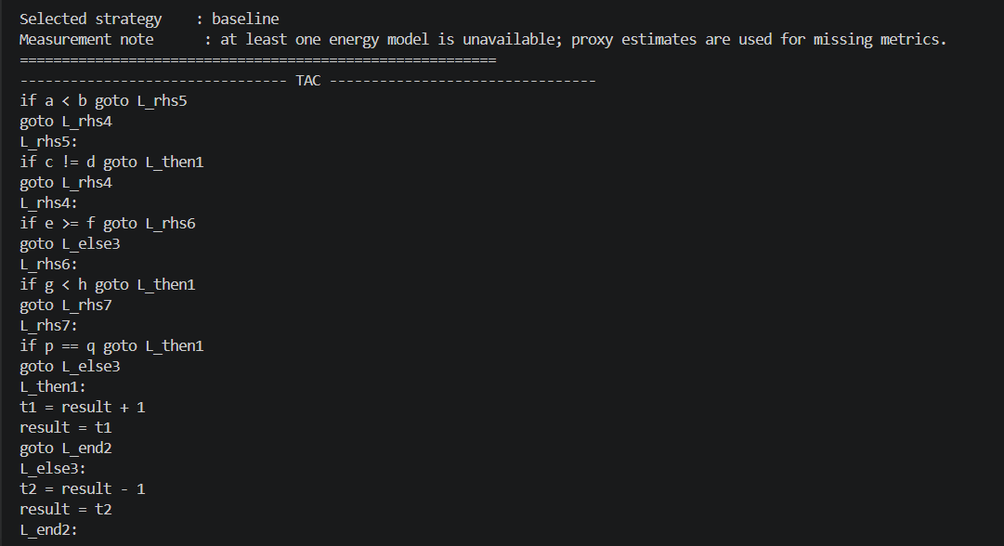
Example 1: Selected final TAC
python run.py green benchmarks/cse.c --compile-ci 700 --runtime-ci 200 --executions 10000
Selected strategy: baseline. Complete output follows in column order.
Notes:
================ GREEN STRATEGY DECISION ================
Model : partial / proxy fallback
Compile-energy model : no
Runtime-energy model : no
Runtime-time model : yes
Energy/CO2e status : PROXY estimates for missing energy models; not measured savings
Compile carbon : 700.0 gCO2e/kWh
Runtime carbon : 200.0 gCO2e/kWh
Expected executions : 10000
Max runtime overhead : 10.0%
Instructions 22
Binary operations 2
Branches 5
Labels 7
Temporaries 2
Basic blocks 18
Expression depth 2
Common subexpressions 0
+----------------+------------+------------+--------------+--------------+---------+
| Strategy | Compile J | Runtime J | Runtime ms | CO2e (g) | Allowed |
+----------------+------------+------------+--------------+--------------+---------+
| baseline | 10.900 | 34.800 | 0.000040353 | 19.335453 | yes |
| lightweight | 12.350 | 34.800 | 0.000039706 | 19.335735 | yes |
| dag | 13.500 | 34.800 | 0.000040923 | 19.335958 | yes |
+----------------+------------+------------+--------------+--------------+---------+
Selected strategy : baseline
Measurement note : at least one energy model is unavailable; proxy estimates are used for missing metrics.
=========================================================
-------------------------------- TAC --------------------------------
if a < b goto L_rhs5
goto L_rhs4
L_rhs5:
if c != d goto L_then1
goto L_rhs4
L_rhs4:
if e >= f goto L_rhs6
goto L_else3
L_rhs6:
if g < h goto L_then1
goto L_rhs7
L_rhs7:
if p == q goto L_then1
goto L_else3
L_then1:
t1 = result + 1
result = t1
goto L_end2
L_else3:
t2 = result - 1
result = t2
L_end2:
------------------------------------------------------------------------

Slide 25
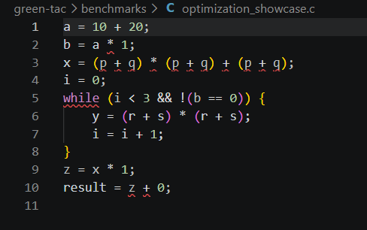
Example 2: Optimization and a while loop
python run.py steps benchmarks/optimization_showcase.c
Arithmetic, assignments and a while loop with a Boolean condition. Constants, neutral arithmetic and repeated expressions expose each optimization pass.
Notes:
Input file: benchmarks/optimization_showcase.c
a = 10 + 20;
b = a * 1;
x = (p + q) * (p + q) + (p + q);
i = 0;
while (i < 3 && !(b == 0)) {
y = (r + s) * (r + s);
i = i + 1;
}
z = x * 1;
result = z + 0;

Slide 26
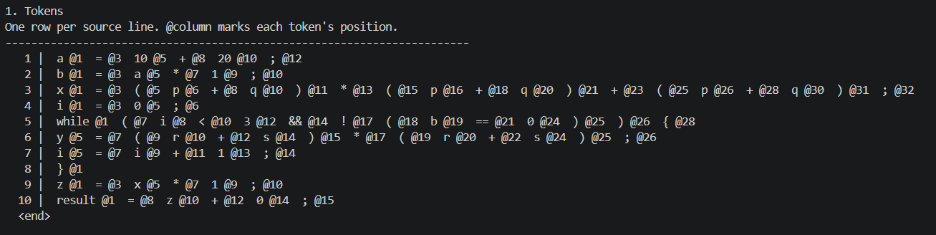
Example 2: Tokens
python run.py steps benchmarks/optimization_showcase.c
Every token and its source column. Long source rows continue on the next display line.
Notes:
Command: python run.py steps benchmarks/optimization_showcase.c
1. Tokens
One row per source line. @column marks each token's position.
1 | a @1 = @3 10 @5 + @8 20 @10 ; @12
2 | b @1 = @3 a @5 * @7 1 @9 ; @10
3 | x @1 = @3 ( @5 p @6 + @8 q @10 ) @11 * @13 ( @15 p @16 + @18 q @20 ) @21 + @23 ( @25 p @26 + @28 q @30 ) @31 ; @32
4 | i @1 = @3 0 @5 ; @6
5 | while @1 ( @7 i @8 < @10 3 @12 && @14 ! @17 ( @18 b @19 == @21 0 @24 ) @25 ) @26 { @28
6 | y @5 = @7 ( @9 r @10 + @12 s @14 ) @15 * @17 ( @19 r @20 + @22 s @24 ) @25 ; @26
7 | i @5 = @7 i @9 + @11 1 @13 ; @14
8 | } @1
9 | z @1 = @3 x @5 * @7 1 @9 ; @10
10 | result @1 = @8 z @10 + @12 0 @14 ; @15
<end>

Slide 27
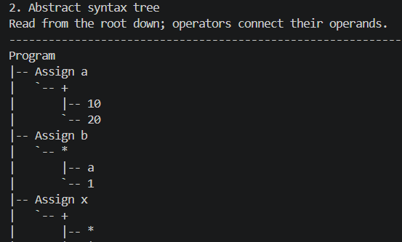
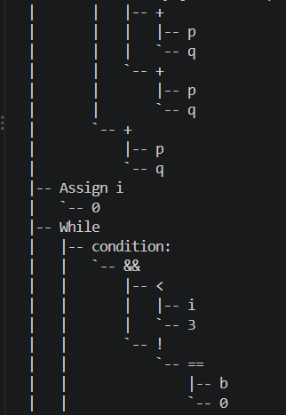
Example 2: Abstract syntax tree (1/2)
python run.py steps benchmarks/optimization_showcase.c
Read the left column first, then continue at the top of the right column.
Program
|-- Assign a
| `-- +
| |-- 10
| `-- 20
|-- Assign b
| `-- *
| |-- a
| `-- 1
|-- Assign x
| `-- +
| |-- *
| | |-- +
| | | |-- p
| | | `-- q
| | `-- +
| | |-- p
| | `-- q
| `-- +
| |-- p
| `-- q
|-- Assign i
| `-- 0
Notes:
Command: python run.py steps benchmarks/optimization_showcase.c
2. Abstract syntax tree
Read from the root down; operators connect their operands.
Program
|-- Assign a
| `-- +
| |-- 10
| `-- 20
|-- Assign b
| `-- *
| |-- a
| `-- 1
|-- Assign x
| `-- +
| |-- *
| | |-- +
| | | |-- p
| | | `-- q
| | `-- +
| | |-- p
| | `-- q
| `-- +
| |-- p
| `-- q
|-- Assign i
| `-- 0
|-- While
| |-- condition:
| | `-- &&
| | |-- <
| | | |-- i
| | | `-- 3
| | `-- !
| | `-- ==
| | |-- b
| | `-- 0
| `-- body:
| `-- Block
| |-- Assign y
| | `-- *
| | |-- +
| | | |-- r
| | | `-- s
| | `-- +
| | |-- r
| | `-- s
| `-- Assign i
| `-- +
| |-- i
| `-- 1
|-- Assign z
| `-- *
| |-- x
| `-- 1
`-- Assign result
`-- +
|-- z
`-- 0

Slide 28
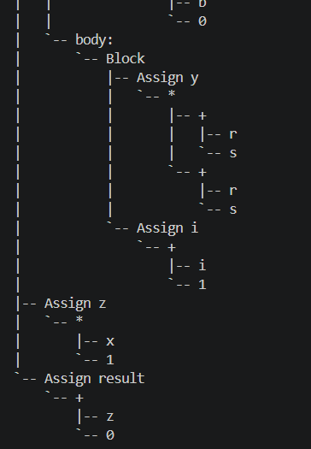
Example 2: Abstract syntax tree (2/2)
python run.py steps benchmarks/optimization_showcase.c
Read the left column first, then continue at the top of the right column.
Notes:
Command: python run.py steps benchmarks/optimization_showcase.c
2. Abstract syntax tree
Read from the root down; operators connect their operands.
Program
|-- Assign a
| `-- +
| |-- 10
| `-- 20
|-- Assign b
| `-- *
| |-- a
| `-- 1
|-- Assign x
| `-- +
| |-- *
| | |-- +
| | | |-- p
| | | `-- q
| | `-- +
| | |-- p
| | `-- q
| `-- +
| |-- p
| `-- q
|-- Assign i
| `-- 0
|-- While
| |-- condition:
| | `-- &&
| | |-- <
| | | |-- i
| | | `-- 3
| | `-- !
| | `-- ==
| | |-- b
| | `-- 0
| `-- body:
| `-- Block
| |-- Assign y
| | `-- *
| | |-- +
| | | |-- r
| | | `-- s
| | `-- +
| | |-- r
| | `-- s
| `-- Assign i
| `-- +
| |-- i
| `-- 1
|-- Assign z
| `-- *
| |-- x
| `-- 1
`-- Assign result
`-- +
|-- z
`-- 0

Slide 29
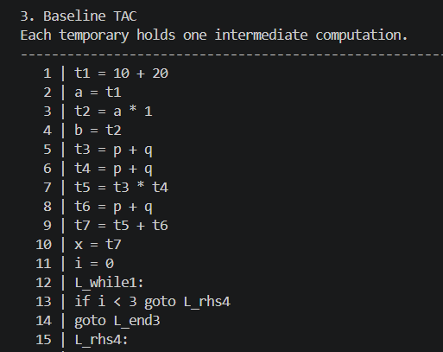
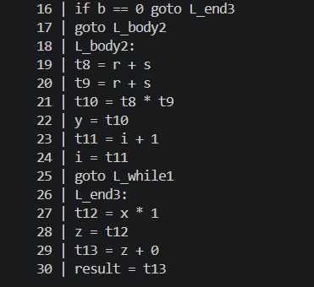
Example 2: Baseline TAC
python run.py steps benchmarks/optimization_showcase.c
30 instructions before optimization. Read the left column, then the right.
1 | t1 = 10 + 20
2 | a = t1
3 | t2 = a * 1
4 | b = t2
5 | t3 = p + q
6 | t4 = p + q
7 | t5 = t3 * t4
8 | t6 = p + q
9 | t7 = t5 + t6
10 | x = t7
11 | i = 0
12 | L_while1:
13 | if i < 3 goto L_rhs4
14 | goto L_end3
15 | L_rhs4:
16 | if b == 0 goto L_end3
17 | goto L_body2
18 | L_body2:
19 | t8 = r + s
20 | t9 = r + s
21 | t10 = t8 * t9
22 | y = t10
23 | t11 = i + 1
24 | i = t11
25 | goto L_while1
26 | L_end3:
27 | t12 = x * 1
28 | z = t12
29 | t13 = z + 0
30 | result = t13
Notes:
Command: python run.py steps benchmarks/optimization_showcase.c
3. Baseline TAC
Each temporary holds one intermediate computation.
1 | t1 = 10 + 20
2 | a = t1
3 | t2 = a * 1
4 | b = t2
5 | t3 = p + q
6 | t4 = p + q
7 | t5 = t3 * t4
8 | t6 = p + q
9 | t7 = t5 + t6
10 | x = t7
11 | i = 0
12 | L_while1:
13 | if i < 3 goto L_rhs4
14 | goto L_end3
15 | L_rhs4:
16 | if b == 0 goto L_end3
17 | goto L_body2
18 | L_body2:
19 | t8 = r + s
20 | t9 = r + s
21 | t10 = t8 * t9
22 | y = t10
23 | t11 = i + 1
24 | i = t11
25 | goto L_while1
26 | L_end3:
27 | t12 = x * 1
28 | z = t12
29 | t13 = z + 0
30 | result = t13

Slide 30
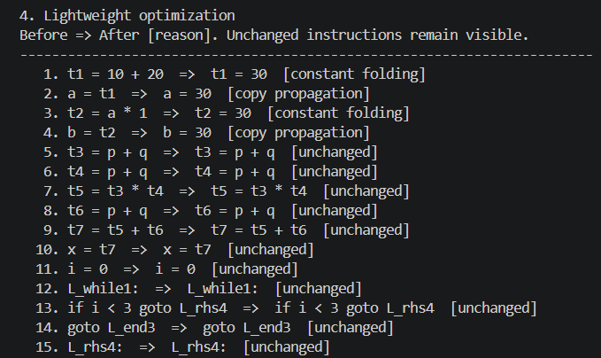
Example 2: Lightweight rewrites (1/2)
python run.py steps benchmarks/optimization_showcase.c
Before => After [reason]. Unchanged instructions remain visible.
Notes:
Command: python run.py steps benchmarks/optimization_showcase.c
4. Lightweight optimization
Before => After [reason]. Unchanged instructions remain visible.
1. t1 = 10 + 20 => t1 = 30 [constant folding]
2. a = t1 => a = 30 [copy propagation]
3. t2 = a * 1 => t2 = 30 [constant folding]
4. b = t2 => b = 30 [copy propagation]
5. t3 = p + q => t3 = p + q [unchanged]
6. t4 = p + q => t4 = p + q [unchanged]
7. t5 = t3 * t4 => t5 = t3 * t4 [unchanged]
8. t6 = p + q => t6 = p + q [unchanged]
9. t7 = t5 + t6 => t7 = t5 + t6 [unchanged]
10. x = t7 => x = t7 [unchanged]
11. i = 0 => i = 0 [unchanged]
12. L_while1: => L_while1: [unchanged]
13. if i < 3 goto L_rhs4 => if i < 3 goto L_rhs4 [unchanged]
14. goto L_end3 => goto L_end3 [unchanged]
15. L_rhs4: => L_rhs4: [unchanged]
16. if b == 0 goto L_end3 => if b == 0 goto L_end3 [unchanged]
17. goto L_body2 => goto L_body2 [unchanged]
18. L_body2: => L_body2: [unchanged]
19. t8 = r + s => t8 = r + s [unchanged]
20. t9 = r + s => t9 = r + s [unchanged]
21. t10 = t8 * t9 => t10 = t8 * t9 [unchanged]
22. y = t10 => y = t10 [unchanged]
23. t11 = i + 1 => t11 = i + 1 [unchanged]
24. i = t11 => i = t11 [unchanged]
25. goto L_while1 => goto L_while1 [unchanged]
26. L_end3: => L_end3: [unchanged]
27. t12 = x * 1 => t12 = x [algebraic simplification]
28. z = t12 => z = x [copy propagation]
29. t13 = z + 0 => t13 = x [algebraic simplification]
30. result = t13 => result = x [copy propagation]

Slide 31
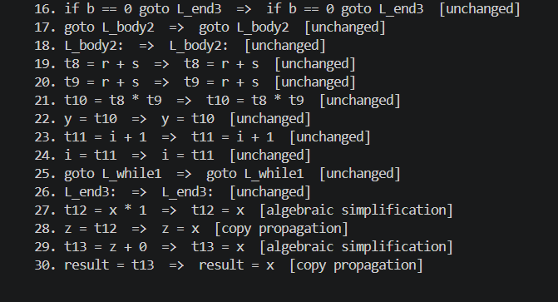
Example 2: Lightweight rewrites (2/2)
python run.py steps benchmarks/optimization_showcase.c
Before => After [reason]. Unchanged instructions remain visible.
Notes:
Command: python run.py steps benchmarks/optimization_showcase.c
4. Lightweight optimization
Before => After [reason]. Unchanged instructions remain visible.
1. t1 = 10 + 20 => t1 = 30 [constant folding]
2. a = t1 => a = 30 [copy propagation]
3. t2 = a * 1 => t2 = 30 [constant folding]
4. b = t2 => b = 30 [copy propagation]
5. t3 = p + q => t3 = p + q [unchanged]
6. t4 = p + q => t4 = p + q [unchanged]
7. t5 = t3 * t4 => t5 = t3 * t4 [unchanged]
8. t6 = p + q => t6 = p + q [unchanged]
9. t7 = t5 + t6 => t7 = t5 + t6 [unchanged]
10. x = t7 => x = t7 [unchanged]
11. i = 0 => i = 0 [unchanged]
12. L_while1: => L_while1: [unchanged]
13. if i < 3 goto L_rhs4 => if i < 3 goto L_rhs4 [unchanged]
14. goto L_end3 => goto L_end3 [unchanged]
15. L_rhs4: => L_rhs4: [unchanged]
16. if b == 0 goto L_end3 => if b == 0 goto L_end3 [unchanged]
17. goto L_body2 => goto L_body2 [unchanged]
18. L_body2: => L_body2: [unchanged]
19. t8 = r + s => t8 = r + s [unchanged]
20. t9 = r + s => t9 = r + s [unchanged]
21. t10 = t8 * t9 => t10 = t8 * t9 [unchanged]
22. y = t10 => y = t10 [unchanged]
23. t11 = i + 1 => t11 = i + 1 [unchanged]
24. i = t11 => i = t11 [unchanged]
25. goto L_while1 => goto L_while1 [unchanged]
26. L_end3: => L_end3: [unchanged]
27. t12 = x * 1 => t12 = x [algebraic simplification]
28. z = t12 => z = x [copy propagation]
29. t13 = z + 0 => t13 = x [algebraic simplification]
30. result = t13 => result = x [copy propagation]

Slide 32
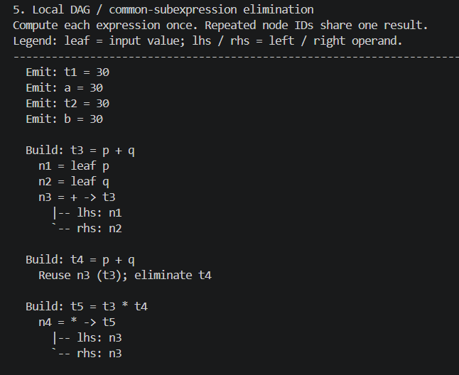
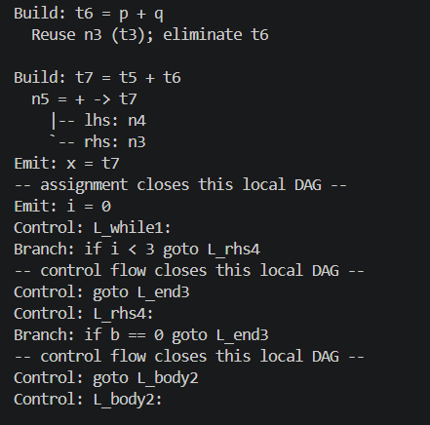
Example 2: DAG / CSE trace (1/2)
python run.py steps benchmarks/optimization_showcase.c
Read the left column first. Reuse marks eliminated expressions. Control flow closes each local DAG.
Emit: t1 = 30
Emit: a = 30
Emit: t2 = 30
Emit: b = 30
Build: t3 = p + q
n1 = leaf p
n2 = leaf q
n3 = + -> t3
|-- lhs: n1
`-- rhs: n2
Build: t4 = p + q
Reuse n3 (t3); eliminate t4
Build: t5 = t3 * t4
n4 = * -> t5
|-- lhs: n3
`-- rhs: n3
Build: t6 = p + q
Reuse n3 (t3); eliminate t6
Build: t7 = t5 + t6
n5 = + -> t7
|-- lhs: n4
`-- rhs: n3
Emit: x = t7
-- assignment closes this local DAG --
Emit: i = 0
Control: L_while1:
Branch: if i < 3 goto L_rhs4
-- control flow closes this local DAG --
Control: goto L_end3
Control: L_rhs4:
Branch: if b == 0 goto L_end3
Notes:
Command: python run.py steps benchmarks/optimization_showcase.c
5. Local DAG / common-subexpression elimination
Compute each expression once. Repeated node IDs share one result.
Legend: leaf = input value; lhs / rhs = left / right operand.
Emit: t1 = 30
Emit: a = 30
Emit: t2 = 30
Emit: b = 30
Build: t3 = p + q
n1 = leaf p
n2 = leaf q
n3 = + -> t3
|-- lhs: n1
`-- rhs: n2
Build: t4 = p + q
Reuse n3 (t3); eliminate t4
Build: t5 = t3 * t4
n4 = * -> t5
|-- lhs: n3
`-- rhs: n3
Build: t6 = p + q
Reuse n3 (t3); eliminate t6
Build: t7 = t5 + t6
n5 = + -> t7
|-- lhs: n4
`-- rhs: n3
Emit: x = t7
-- assignment closes this local DAG --
Emit: i = 0
Control: L_while1:
Branch: if i < 3 goto L_rhs4
-- control flow closes this local DAG --
Control: goto L_end3
Control: L_rhs4:
Branch: if b == 0 goto L_end3
-- control flow closes this local DAG --
Control: goto L_body2
Control: L_body2:
Build: t8 = r + s
n6 = leaf r
n7 = leaf s
n8 = + -> t8
|-- lhs: n6
`-- rhs: n7
Build: t9 = r + s
Reuse n8 (t8); eliminate t9
Build: t10 = t8 * t9
n9 = * -> t10
|-- lhs: n8
`-- rhs: n8
Emit: y = t10
-- assignment closes this local DAG --
Build: t11 = i + 1
n10 = leaf i
n11 = leaf 1
n12 = + -> t11
|-- lhs: n10
`-- rhs: n11
Emit: i = t11
-- assignment closes this local DAG --
Control: goto L_while1
Control: L_end3:
Emit: t12 = x
Emit: z = x
Emit: t13 = x
Emit: result = x

Slide 33
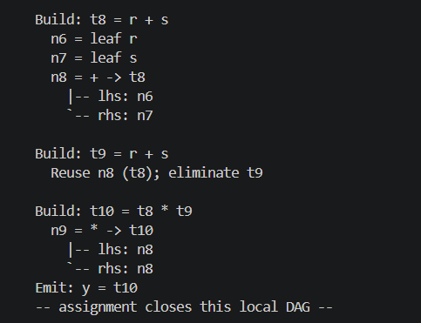
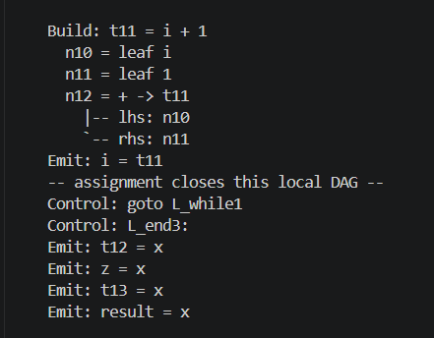
Example 2: DAG / CSE trace (2/2)
python run.py steps benchmarks/optimization_showcase.c
Read the left column first. Reuse marks eliminated expressions. Control flow closes each local DAG.
Notes:
Command: python run.py steps benchmarks/optimization_showcase.c
5. Local DAG / common-subexpression elimination
Compute each expression once. Repeated node IDs share one result.
Legend: leaf = input value; lhs / rhs = left / right operand.
Emit: t1 = 30
Emit: a = 30
Emit: t2 = 30
Emit: b = 30
Build: t3 = p + q
n1 = leaf p
n2 = leaf q
n3 = + -> t3
|-- lhs: n1
`-- rhs: n2
Build: t4 = p + q
Reuse n3 (t3); eliminate t4
Build: t5 = t3 * t4
n4 = * -> t5
|-- lhs: n3
`-- rhs: n3
Build: t6 = p + q
Reuse n3 (t3); eliminate t6
Build: t7 = t5 + t6
n5 = + -> t7
|-- lhs: n4
`-- rhs: n3
Emit: x = t7
-- assignment closes this local DAG --
Emit: i = 0
Control: L_while1:
Branch: if i < 3 goto L_rhs4
-- control flow closes this local DAG --
Control: goto L_end3
Control: L_rhs4:
Branch: if b == 0 goto L_end3
-- control flow closes this local DAG --
Control: goto L_body2
Control: L_body2:
Build: t8 = r + s
n6 = leaf r
n7 = leaf s
n8 = + -> t8
|-- lhs: n6
`-- rhs: n7
Build: t9 = r + s
Reuse n8 (t8); eliminate t9
Build: t10 = t8 * t9
n9 = * -> t10
|-- lhs: n8
`-- rhs: n8
Emit: y = t10
-- assignment closes this local DAG --
Build: t11 = i + 1
n10 = leaf i
n11 = leaf 1
n12 = + -> t11
|-- lhs: n10
`-- rhs: n11
Emit: i = t11
-- assignment closes this local DAG --
Control: goto L_while1
Control: L_end3:
Emit: t12 = x
Emit: z = x
Emit: t13 = x
Emit: result = x

Slide 34
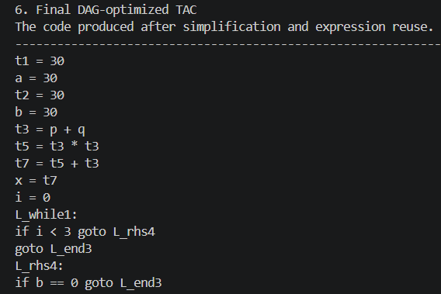
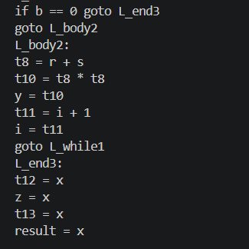
Example 2: Final DAG TAC
python run.py steps benchmarks/optimization_showcase.c
Complete optimized TAC. Read the left column, then continue on the right.
t1 = 30
a = 30
t2 = 30
b = 30
t3 = p + q
t5 = t3 * t3
t7 = t5 + t3
x = t7
i = 0
L_while1:
if i < 3 goto L_rhs4
goto L_end3
L_rhs4:
if b == 0 goto L_end3
goto L_body2
L_body2:
t8 = r + s
t10 = t8 * t8
y = t10
t11 = i + 1
i = t11
goto L_while1
L_end3:
t12 = x
z = x
t13 = x
result = x
Notes:
Command: python run.py steps benchmarks/optimization_showcase.c
6. Final DAG-optimized TAC
The code produced after simplification and expression reuse.
t1 = 30
a = 30
t2 = 30
b = 30
t3 = p + q
t5 = t3 * t3
t7 = t5 + t3
x = t7
i = 0
L_while1:
if i < 3 goto L_rhs4
goto L_end3
L_rhs4:
if b == 0 goto L_end3
goto L_body2
L_body2:
t8 = r + s
t10 = t8 * t8
y = t10
t11 = i + 1
i = t11
goto L_while1
L_end3:
t12 = x
z = x
t13 = x
result = x

Slide 35
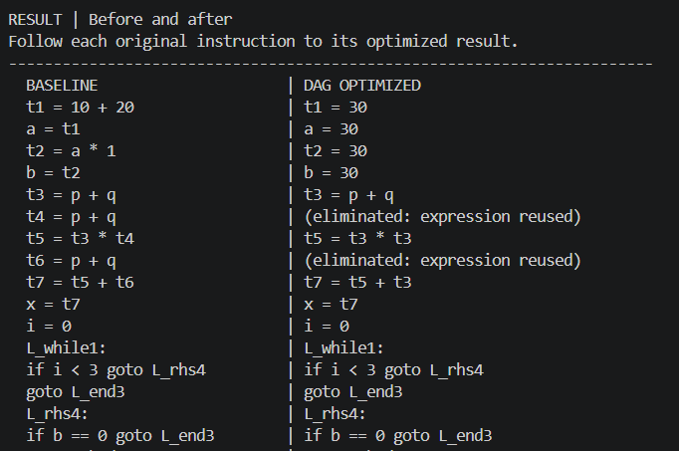
Example 2: Before and after (1/2)
python run.py steps benchmarks/optimization_showcase.c
Every baseline instruction appears beside its optimized result.
Notes:
Command: python run.py steps benchmarks/optimization_showcase.c
RESULT | Before and after
Follow each original instruction to its optimized result.
BASELINE | DAG OPTIMIZED
t1 = 10 + 20 | t1 = 30
a = t1 | a = 30
t2 = a * 1 | t2 = 30
b = t2 | b = 30
t3 = p + q | t3 = p + q
t4 = p + q | (eliminated: expression reused)
t5 = t3 * t4 | t5 = t3 * t3
t6 = p + q | (eliminated: expression reused)
t7 = t5 + t6 | t7 = t5 + t3
x = t7 | x = t7
i = 0 | i = 0
L_while1: | L_while1:
if i < 3 goto L_rhs4 | if i < 3 goto L_rhs4
goto L_end3 | goto L_end3
L_rhs4: | L_rhs4:
if b == 0 goto L_end3 | if b == 0 goto L_end3
goto L_body2 | goto L_body2
L_body2: | L_body2:
t8 = r + s | t8 = r + s
t9 = r + s | (eliminated: expression reused)
t10 = t8 * t9 | t10 = t8 * t8
y = t10 | y = t10
t11 = i + 1 | t11 = i + 1
i = t11 | i = t11
goto L_while1 | goto L_while1
L_end3: | L_end3:
t12 = x * 1 | t12 = x
z = t12 | z = x
t13 = z + 0 | t13 = x
result = t13 | result = x
Instructions: 30 -> 27 | Removed: 3

Slide 36
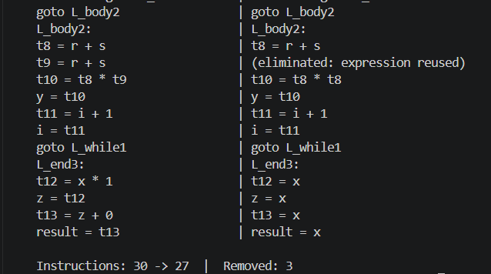
Example 2: Before and after (2/2)
python run.py steps benchmarks/optimization_showcase.c
Every baseline instruction appears beside its optimized result.
Notes:
Command: python run.py steps benchmarks/optimization_showcase.c
RESULT | Before and after
Follow each original instruction to its optimized result.
BASELINE | DAG OPTIMIZED
t1 = 10 + 20 | t1 = 30
a = t1 | a = 30
t2 = a * 1 | t2 = 30
b = t2 | b = 30
t3 = p + q | t3 = p + q
t4 = p + q | (eliminated: expression reused)
t5 = t3 * t4 | t5 = t3 * t3
t6 = p + q | (eliminated: expression reused)
t7 = t5 + t6 | t7 = t5 + t3
x = t7 | x = t7
i = 0 | i = 0
L_while1: | L_while1:
if i < 3 goto L_rhs4 | if i < 3 goto L_rhs4
goto L_end3 | goto L_end3
L_rhs4: | L_rhs4:
if b == 0 goto L_end3 | if b == 0 goto L_end3
goto L_body2 | goto L_body2
L_body2: | L_body2:
t8 = r + s | t8 = r + s
t9 = r + s | (eliminated: expression reused)
t10 = t8 * t9 | t10 = t8 * t8
y = t10 | y = t10
t11 = i + 1 | t11 = i + 1
i = t11 | i = t11
goto L_while1 | goto L_while1
L_end3: | L_end3:
t12 = x * 1 | t12 = x
z = t12 | z = x
t13 = z + 0 | t13 = x
result = t13 | result = x
Instructions: 30 -> 27 | Removed: 3

Slide 37
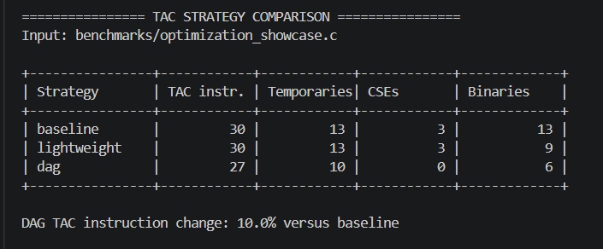
Example 2: Strategy comparison
python run.py compare benchmarks/optimization_showcase.c
DAG removes 3 of 30 TAC instructions (10.0%). Binary operations fall from 13 to 6. Lightweight rewrites reduce arithmetic even when the instruction count stays at 30.
Notes:
================ TAC STRATEGY COMPARISON ================
Input: benchmarks/optimization_showcase.c
+----------------+------------+------------+------------+-------------+
| Strategy | TAC instr. | Temporaries| CSEs | Binaries |
+----------------+------------+------------+------------+-------------+
| baseline | 30 | 13 | 3 | 13 |
| lightweight | 30 | 13 | 3 | 9 |
| dag | 27 | 10 | 0 | 6 |
+----------------+------------+------------+------------+-------------+
DAG TAC instruction change: 10.0% versus baseline
### baseline
-------------------------------- TAC --------------------------------
t1 = 10 + 20
a = t1
t2 = a * 1
b = t2
t3 = p + q
t4 = p + q
t5 = t3 * t4
t6 = p + q
t7 = t5 + t6
x = t7
i = 0
L_while1:
if i < 3 goto L_rhs4
goto L_end3
L_rhs4:
if b == 0 goto L_end3
goto L_body2
L_body2:
t8 = r + s
t9 = r + s
t10 = t8 * t9
y = t10
t11 = i + 1
i = t11
goto L_while1
L_end3:
t12 = x * 1
z = t12
t13 = z + 0
result = t13
------------------------------------------------------------------------
### lightweight
-------------------------------- TAC --------------------------------
t1 = 30
a = 30
t2 = 30
b = 30
t3 = p + q
t4 = p + q
t5 = t3 * t4
t6 = p + q
t7 = t5 + t6
x = t7
i = 0
L_while1:
if i < 3 goto L_rhs4
goto L_end3
L_rhs4:
if b == 0 goto L_end3
goto L_body2
L_body2:
t8 = r + s
t9 = r + s
t10 = t8 * t9
y = t10
t11 = i + 1
i = t11
goto L_while1
L_end3:
t12 = x
z = x
t13 = x
result = x
------------------------------------------------------------------------
### dag
-------------------------------- TAC --------------------------------
t1 = 30
a = 30
t2 = 30
b = 30
t3 = p + q
t5 = t3 * t3
t7 = t5 + t3
x = t7
i = 0
L_while1:
if i < 3 goto L_rhs4
goto L_end3
L_rhs4:
if b == 0 goto L_end3
goto L_body2
L_body2:
t8 = r + s
t10 = t8 * t8
y = t10
t11 = i + 1
i = t11
goto L_while1
L_end3:
t12 = x
z = x
t13 = x
result = x
------------------------------------------------------------------------
CSEs counts repeated expressions remaining in the output, not the number of expressions removed.

Slide 38
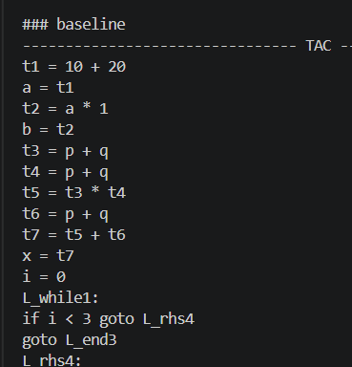
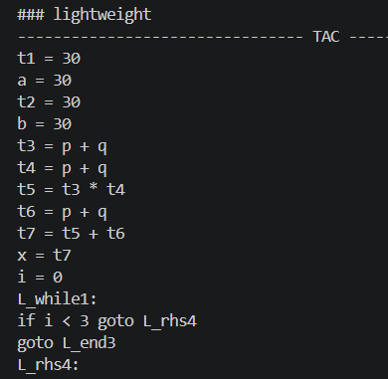
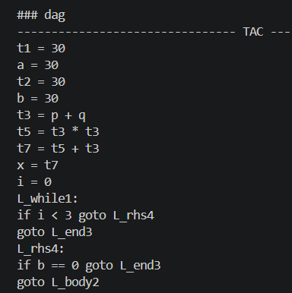
Example 2: TAC across all strategies (1/2)
python run.py compare benchmarks/optimization_showcase.c
BASELINE
LIGHTWEIGHT
DAG
Notes:
================ TAC STRATEGY COMPARISON ================
Input: benchmarks/optimization_showcase.c
+----------------+------------+------------+------------+-------------+
| Strategy | TAC instr. | Temporaries| CSEs | Binaries |
+----------------+------------+------------+------------+-------------+
| baseline | 30 | 13 | 3 | 13 |
| lightweight | 30 | 13 | 3 | 9 |
| dag | 27 | 10 | 0 | 6 |
+----------------+------------+------------+------------+-------------+
DAG TAC instruction change: 10.0% versus baseline
### baseline
-------------------------------- TAC --------------------------------
t1 = 10 + 20
a = t1
t2 = a * 1
b = t2
t3 = p + q
t4 = p + q
t5 = t3 * t4
t6 = p + q
t7 = t5 + t6
x = t7
i = 0
L_while1:
if i < 3 goto L_rhs4
goto L_end3
L_rhs4:
if b == 0 goto L_end3
goto L_body2
L_body2:
t8 = r + s
t9 = r + s
t10 = t8 * t9
y = t10
t11 = i + 1
i = t11
goto L_while1
L_end3:
t12 = x * 1
z = t12
t13 = z + 0
result = t13
------------------------------------------------------------------------
### lightweight
-------------------------------- TAC --------------------------------
t1 = 30
a = 30
t2 = 30
b = 30
t3 = p + q
t4 = p + q
t5 = t3 * t4
t6 = p + q
t7 = t5 + t6
x = t7
i = 0
L_while1:
if i < 3 goto L_rhs4
goto L_end3
L_rhs4:
if b == 0 goto L_end3
goto L_body2
L_body2:
t8 = r + s
t9 = r + s
t10 = t8 * t9
y = t10
t11 = i + 1
i = t11
goto L_while1
L_end3:
t12 = x
z = x
t13 = x
result = x
------------------------------------------------------------------------
### dag
-------------------------------- TAC --------------------------------
t1 = 30
a = 30
t2 = 30
b = 30
t3 = p + q
t5 = t3 * t3
t7 = t5 + t3
x = t7
i = 0
L_while1:
if i < 3 goto L_rhs4
goto L_end3
L_rhs4:
if b == 0 goto L_end3
goto L_body2
L_body2:
t8 = r + s
t10 = t8 * t8
y = t10
t11 = i + 1
i = t11
goto L_while1
L_end3:
t12 = x
z = x
t13 = x
result = x
------------------------------------------------------------------------

Slide 39
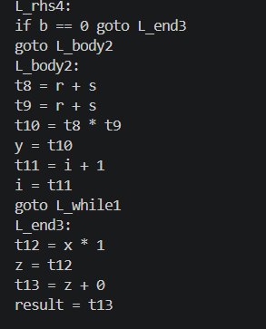
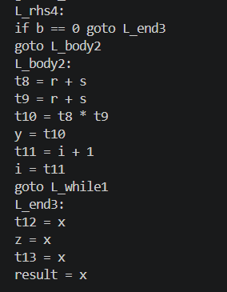
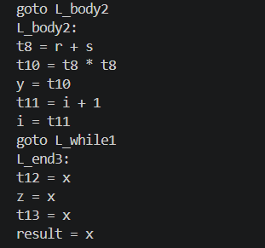
Example 2: TAC across all strategies (2/2)
python run.py compare benchmarks/optimization_showcase.c
BASELINE
LIGHTWEIGHT
DAG
Notes:
================ TAC STRATEGY COMPARISON ================
Input: benchmarks/optimization_showcase.c
+----------------+------------+------------+------------+-------------+
| Strategy | TAC instr. | Temporaries| CSEs | Binaries |
+----------------+------------+------------+------------+-------------+
| baseline | 30 | 13 | 3 | 13 |
| lightweight | 30 | 13 | 3 | 9 |
| dag | 27 | 10 | 0 | 6 |
+----------------+------------+------------+------------+-------------+
DAG TAC instruction change: 10.0% versus baseline
### baseline
-------------------------------- TAC --------------------------------
t1 = 10 + 20
a = t1
t2 = a * 1
b = t2
t3 = p + q
t4 = p + q
t5 = t3 * t4
t6 = p + q
t7 = t5 + t6
x = t7
i = 0
L_while1:
if i < 3 goto L_rhs4
goto L_end3
L_rhs4:
if b == 0 goto L_end3
goto L_body2
L_body2:
t8 = r + s
t9 = r + s
t10 = t8 * t9
y = t10
t11 = i + 1
i = t11
goto L_while1
L_end3:
t12 = x * 1
z = t12
t13 = z + 0
result = t13
------------------------------------------------------------------------
### lightweight
-------------------------------- TAC --------------------------------
t1 = 30
a = 30
t2 = 30
b = 30
t3 = p + q
t4 = p + q
t5 = t3 * t4
t6 = p + q
t7 = t5 + t6
x = t7
i = 0
L_while1:
if i < 3 goto L_rhs4
goto L_end3
L_rhs4:
if b == 0 goto L_end3
goto L_body2
L_body2:
t8 = r + s
t9 = r + s
t10 = t8 * t9
y = t10
t11 = i + 1
i = t11
goto L_while1
L_end3:
t12 = x
z = x
t13 = x
result = x
------------------------------------------------------------------------
### dag
-------------------------------- TAC --------------------------------
t1 = 30
a = 30
t2 = 30
b = 30
t3 = p + q
t5 = t3 * t3
t7 = t5 + t3
x = t7
i = 0
L_while1:
if i < 3 goto L_rhs4
goto L_end3
L_rhs4:
if b == 0 goto L_end3
goto L_body2
L_body2:
t8 = r + s
t10 = t8 * t8
y = t10
t11 = i + 1
i = t11
goto L_while1
L_end3:
t12 = x
z = x
t13 = x
result = x
------------------------------------------------------------------------

Slide 40
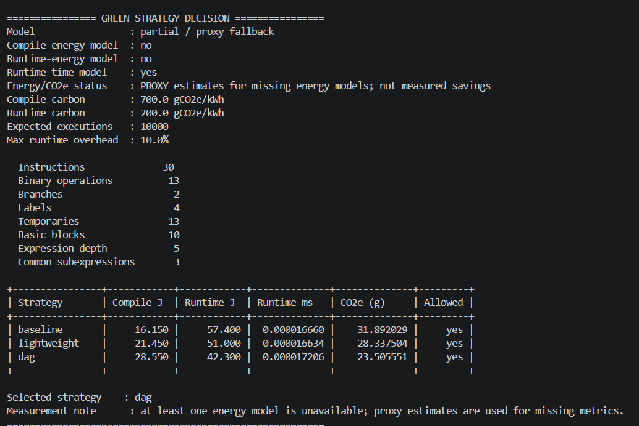
Example 2: Selector inputs and features
$python run.py green benchmarks/optimization_showcase.c --compile-ci 700 --runtime-ci 200 --executions 10000
Energy and CO2e use proxy estimates. The fitted runtime model has poor documented holdout accuracy.
Notes:
================ GREEN STRATEGY DECISION ================
Model : partial / proxy fallback
Compile-energy model : no
Runtime-energy model : no
Runtime-time model : yes
Energy/CO2e status : PROXY estimates for missing energy models; not measured savings
Compile carbon : 700.0 gCO2e/kWh
Runtime carbon : 200.0 gCO2e/kWh
Expected executions : 10000
Max runtime overhead : 10.0%
Instructions 30
Binary operations 13
Branches 2
Labels 4
Temporaries 13
Basic blocks 10
Expression depth 5
Common subexpressions 3
+----------------+------------+------------+--------------+--------------+---------+
| Strategy | Compile J | Runtime J | Runtime ms | CO2e (g) | Allowed |
+----------------+------------+------------+--------------+--------------+---------+
| baseline | 16.150 | 57.400 | 0.000016660 | 31.892029 | yes |
| lightweight | 21.450 | 51.000 | 0.000016634 | 28.337504 | yes |
| dag | 28.550 | 42.300 | 0.000017206 | 23.505551 | yes |
+----------------+------------+------------+--------------+--------------+---------+
Selected strategy : dag
Measurement note : at least one energy model is unavailable; proxy estimates are used for missing metrics.
=========================================================
-------------------------------- TAC --------------------------------
t1 = 30
a = 30
t2 = 30
b = 30
t3 = p + q
t5 = t3 * t3
t7 = t5 + t3
x = t7
i = 0
L_while1:
if i < 3 goto L_rhs4
goto L_end3
L_rhs4:
if b == 0 goto L_end3
goto L_body2
L_body2:
t8 = r + s
t10 = t8 * t8
y = t10
t11 = i + 1
i = t11
goto L_while1
L_end3:
t12 = x
z = x
t13 = x
result = x
------------------------------------------------------------------------

Slide 41
Example 2: Carbon-aware decision
python run.py green benchmarks/optimization_showcase.c --compile-ci 700 --runtime-ci 200 --executions 10000
Strategy | Compile J | Runtime J | Runtime ms | CO2e (g) | Allowed
baseline | 16.150 | 57.400 | 0.000016660 | 31.892029 | yes
lightweight | 21.450 | 51.000 | 0.000016634 | 28.337504 | yes
dag | 28.550 | 42.300 | 0.000017206 | 23.505551 | yes
Selected strategy: dag
DAG wins in this scenario because its lower runtime-energy proxy offsets its higher compile-energy proxy over 10,000 executions.
PROXY energy and CO2e estimates. These values do not establish measured energy savings or a reliable runtime guarantee.
Notes:
================ GREEN STRATEGY DECISION ================
Model : partial / proxy fallback
Compile-energy model : no
Runtime-energy model : no
Runtime-time model : yes
Energy/CO2e status : PROXY estimates for missing energy models; not measured savings
Compile carbon : 700.0 gCO2e/kWh
Runtime carbon : 200.0 gCO2e/kWh
Expected executions : 10000
Max runtime overhead : 10.0%
Instructions 30
Binary operations 13
Branches 2
Labels 4
Temporaries 13
Basic blocks 10
Expression depth 5
Common subexpressions 3
+----------------+------------+------------+--------------+--------------+---------+
| Strategy | Compile J | Runtime J | Runtime ms | CO2e (g) | Allowed |
+----------------+------------+------------+--------------+--------------+---------+
| baseline | 16.150 | 57.400 | 0.000016660 | 31.892029 | yes |
| lightweight | 21.450 | 51.000 | 0.000016634 | 28.337504 | yes |
| dag | 28.550 | 42.300 | 0.000017206 | 23.505551 | yes |
+----------------+------------+------------+--------------+--------------+---------+
Selected strategy : dag
Measurement note : at least one energy model is unavailable; proxy estimates are used for missing metrics.
=========================================================
-------------------------------- TAC --------------------------------
t1 = 30
a = 30
t2 = 30
b = 30
t3 = p + q
t5 = t3 * t3
t7 = t5 + t3
x = t7
i = 0
L_while1:
if i < 3 goto L_rhs4
goto L_end3
L_rhs4:
if b == 0 goto L_end3
goto L_body2
L_body2:
t8 = r + s
t10 = t8 * t8
y = t10
t11 = i + 1
i = t11
goto L_while1
L_end3:
t12 = x
z = x
t13 = x
result = x
------------------------------------------------------------------------

Slide 42
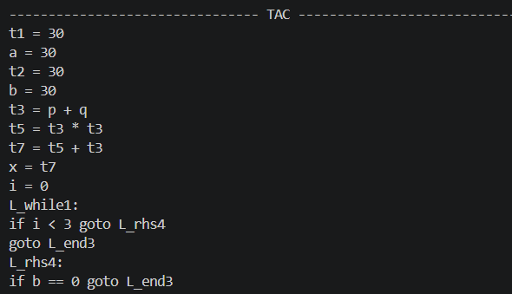
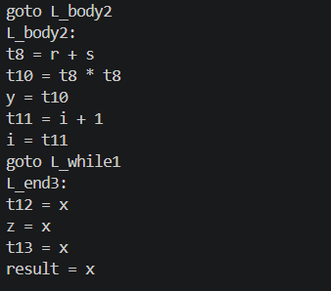
Example 2: Selected final TAC
python run.py green benchmarks/optimization_showcase.c --compile-ci 700 --runtime-ci 200 --executions 10000
Selected strategy: dag. Complete output follows in column order.
Notes:
================ GREEN STRATEGY DECISION ================
Model : partial / proxy fallback
Compile-energy model : no
Runtime-energy model : no
Runtime-time model : yes
Energy/CO2e status : PROXY estimates for missing energy models; not measured savings
Compile carbon : 700.0 gCO2e/kWh
Runtime carbon : 200.0 gCO2e/kWh
Expected executions : 10000
Max runtime overhead : 10.0%
Instructions 30
Binary operations 13
Branches 2
Labels 4
Temporaries 13
Basic blocks 10
Expression depth 5
Common subexpressions 3
+----------------+------------+------------+--------------+--------------+---------+
| Strategy | Compile J | Runtime J | Runtime ms | CO2e (g) | Allowed |
+----------------+------------+------------+--------------+--------------+---------+
| baseline | 16.150 | 57.400 | 0.000016660 | 31.892029 | yes |
| lightweight | 21.450 | 51.000 | 0.000016634 | 28.337504 | yes |
| dag | 28.550 | 42.300 | 0.000017206 | 23.505551 | yes |
+----------------+------------+------------+--------------+--------------+---------+
Selected strategy : dag
Measurement note : at least one energy model is unavailable; proxy estimates are used for missing metrics.
=========================================================
-------------------------------- TAC --------------------------------
t1 = 30
a = 30
t2 = 30
b = 30
t3 = p + q
t5 = t3 * t3
t7 = t5 + t3
x = t7
i = 0
L_while1:
if i < 3 goto L_rhs4
goto L_end3
L_rhs4:
if b == 0 goto L_end3
goto L_body2
L_body2:
t8 = r + s
t10 = t8 * t8
y = t10
t11 = i + 1
i = t11
goto L_while1
L_end3:
t12 = x
z = x
t13 = x
result = x
------------------------------------------------------------------------

Slide 43
Evaluation Plan
Four policies compared on the same corpus
Policy | Description
Always baseline | No optimization on every program
Always lightweight | Low-cost pass on every program
Always DAG | Full DAG/CSE on every program
Green adaptive | Per-program carbon-aware choice
Metrics reported
Compilation time and energy
Runtime and runtime energy
Total energy and CO2e
TAC instruction count, temporaries
CSE count
Runtime-overhead constraint
Selector prediction error

Slide 44
Demonstration Results
Actual TAC output from both examples. Energy and CO2e remain proxy estimates.
Example | Baseline TAC | DAG TAC | Instructions removed | Binary operations
Boolean if/else | 22 | 22 | 0 | 2 to 2
Optimization + while | 30 | 27 | 3 (10.0%) | 13 to 6
The Boolean example demonstrates correct short-circuit branches. The second example shows constant folding, algebraic simplification, copy propagation and local CSE while preserving the loop.
Instruction reductions describe static TAC. They do not by themselves establish measured runtime, energy or carbon savings.
Notes:
Source: current compiler outputs for python run.py compare benchmarks/cse.c and python run.py compare benchmarks/optimization_showcase.c. The proxy selector chooses baseline for Example 1 and DAG for Example 2 at compile CI 700, runtime CI 200, N 10000 and maximum runtime overhead 10%. No measured energy savings claim.

Slide 45
Conclusion and Future Work
Key takeaways
Future work
Optimization has a carbon cost at compile time and a payoff at runtime
Separate compile and runtime carbon intensities make the choice meaningful
An adaptive selector picks the strategy per program and workload
Calibrate the model on larger real RAPL datasets
Use hourly grid carbon intensity data
Add global data-flow optimization and more target back ends

Slide 46
Thank you
github.com/Lakshyajeet3103/Green-TAC

